Slide 1


Fuel Efficiency Prediction and Analysis
This project focuses on Fuel Efficiency Prediction and Analysis to provide valuable automotive insights. A machine learning model is developed to accurately predict fuel efficiency based on factors like engine specifications, vehicle weight, fuel type, and driving conditions. The deliverables include a detailed report outlining methodologies and insightful visualizations to enhance understanding and decision-making. 🚗⛽
by Dinal Pandya
DP
Notes:
1

Slide 2

Introduction:
OBJECTIVE
IMPORTENCE
The objective of this project is to develop an accurate fuel efficiency prediction model based on vehicle attributes such as engine specifications, weight, fuel type, driving conditions, and external environmental factors. This predictive approach aims to help manufacturers optimize vehicle performance, assist consumers in making fuel-efficient choices, and support policymakers in developing sustainable transportation strategies to reduce fuel consumption and emissions.
The importance of a fuel efficiency prediction project lies in its ability to optimize fuel consumption, reduce emissions, and promote sustainable transportation. By accurately predicting fuel efficiency, it helps manufacturers design more energy-efficient vehicles, assists consumers in making cost-effective choices, and supports policymakers in developing eco-friendly regulations. Ultimately, this project contributes to reducing environmental impact and enhancing overall energy sustainability.
Notes:
2

Slide 3
Work Flow
Data Collection
Gathering and organizing data to train machine learning models.
Exploratory Data Analysis
Analyzing and visualizing data patterns to understand its characteristics.
Preprocessing
Preparing and cleaning data to enhance its quality and suitability.
Split Train & Test Data
Dividing the dataset into training and testing sets to evaluate.
Model Selection & Model Training
Choosing a suitable machine learning algorithm and optimizing its parameters.
Model Evaluation
Assessing the performance of machine learning model using metrics.
Conclusion
In conclusion, evaluating the performance of machine learning models using various metrics ensures accurate and reliable predictions.
Notes:
3

Slide 4
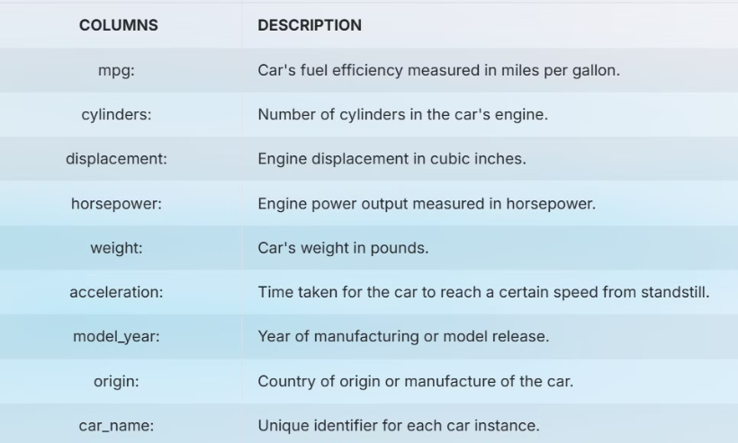
1.​DATA​ COLLECTION
The Fuel Efficiency Prediction dataset is collected from various vehicle specifications and performance metrics that influence fuel consumption.
The dataset includes key attributes such as mpg (miles per gallon), which represents the fuel efficiency of a car, and engine specifications like the number of cylinders, displacement (cubic inches), and horsepower. It also incorporates vehicle weight, acceleration (time taken to reach a certain speed), and the model year to assess the impact of technological advancements on fuel efficiency.
Additionally, the origin of the car is recorded to analyze regional design differences, while the car name serves as a unique identifier.
Notes:
4

Slide 5


2.Exploratory Data Analysis (EDA)
EDA was conducted to understand the dataset's structure, distribution, and relationships between features. It involved analyzing vehicle specifications, performance metrics, and fuel efficiency through statistical summaries and visualizations.
Insights were gained into the impact of engine displacement, weight, horsepower, and acceleration on fuel consumption, helping identify key factors influencing fuel efficiency for model development.
Notes:
5

Slide 6
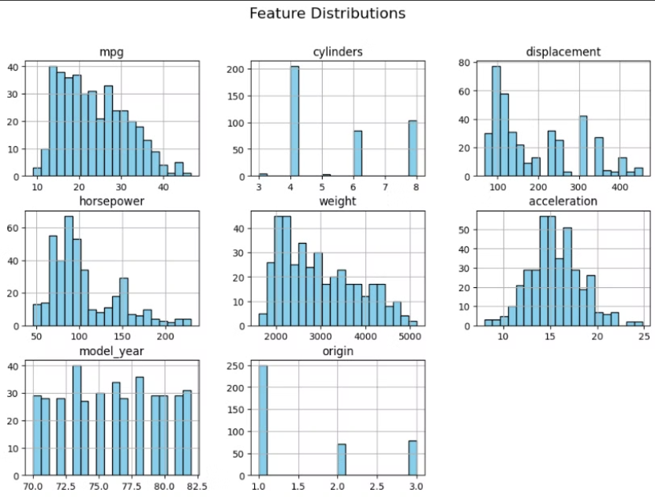
Distribution Of Numeric Features
The image shows histograms of key features in a Fuel Efficiency Prediction dataset.
mpg: Right-skewed, most vehicles have lower fuel efficiency.
Cylinders & Origin: Categorical, with peaks at common values (4, 6, 8 cylinders; 3 origins).
Displacement & Horsepower: Right-skewed, smaller engines and lower horsepower are more common.
Weight: Slightly skewed, most vehicles fall in a mid-range weight.
Acceleration: Nearly normal, centered around 15 seconds.
Model Year: Uniformly distributed across different years.
These distributions help analyze fuel efficiency trends and vehicle characteristics.
Notes:
6

Slide 7
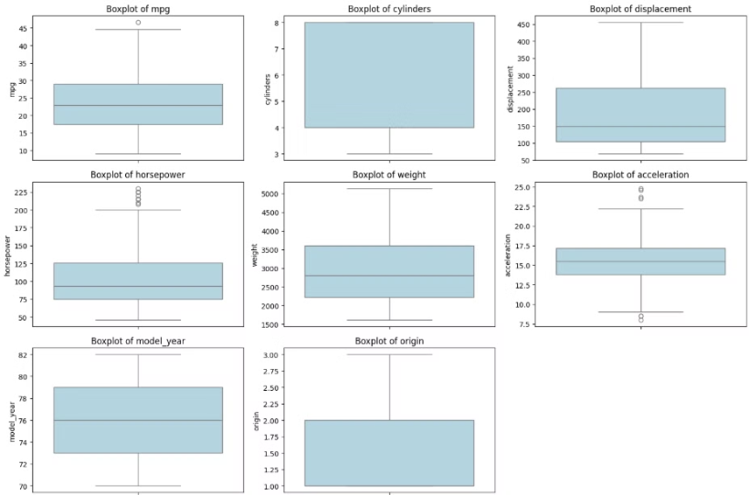
Boxplots
This image displays boxplots of different vehicle features, helping identify distributions, medians, and outliers.
mpg, horsepower, acceleration: Show outliers at higher values.
Cylinders, displacement, weight: Wide interquartile ranges, indicating large variations.
Model year & origin: Discrete distributions with fewer variations.
Acceleration & horsepower: Have noticeable outliers, suggesting some extreme values.
These boxplots highlight variability and potential outliers in the dataset, aiding in preprocessing decisions.
Notes:
7

Slide 8
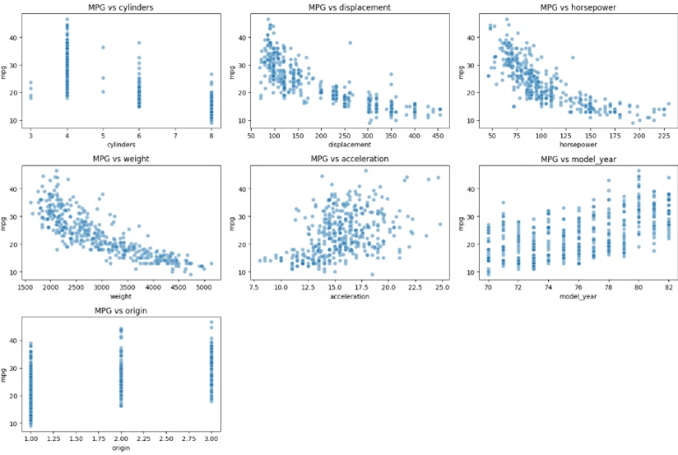
scatter plots
This image presents scatter plots illustrating the relationships between miles per gallon (MPG) and various vehicle attributes.
Observations:
MPG vs Cylinders & Origin: Discrete clusters suggest categorical relationships.
MPG vs Displacement, Horsepower, Weight: Strong negative correlations—higher values in these features lead to lower MPG.
MPG vs Acceleration: Weak correlation, suggesting acceleration has minimal impact on MPG.
MPG vs Model Year: Positive correlation—newer models tend to have higher MPG.
These scatter plots help identify key predictors for fuel efficiency analysis.
Notes:
8

Slide 9
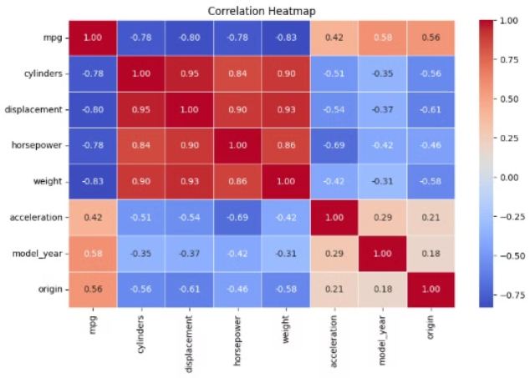
Correlation Heatmap
Key Insights:
MPG has strong negative correlations with:
Weight (-0.83), Displacement (-0.80), Cylinders (-0.78), and Horsepower (-0.78) → Heavier and more powerful vehicles tend to have lower fuel efficiency.
MPG has a moderate positive correlation with:
Model Year (0.58) and Origin (0.56) → Newer models and certain regions have better fuel efficiency.
High positive correlations between:
Cylinders, Displacement, Horsepower, and Weight (above 0.90) → Larger engines with more cylinders tend to be heavier and more powerful.
This heatmap helps in feature selection for fuel efficiency prediction models.
Notes:
9

Slide 10


​3. Data​ Preprocessing
Preparing the data for analysis involves cleaning, transforming, and formatting the raw data. This step is crucial for ensuring data quality and improving the accuracy of our model.
1
Irrelevant Feature Removal
Removed columns that did not contribute meaningful information: 'car_names'.
2
Handling Missing Values
there is no missing values in the dataset but the one feature "horsepower" has integer values with some unwanted values like '?'. so the features dtype represent the feature as object column so i replace the '?' data with 'Nan' then the 'Nan' count is 6 so then i handle this with using of median.
3
Outlier Detection and Treatment
Outlier detection conducted using IQR and Z-score methods. remove the outliers using IQR.
4
transformer
transformed the skewed data using log1p.
5
Feature Scaling
Standard Scaling applied to numerical features (mean=0, standard deviation=1).
Notes:
10

Slide 11



4.Train/Test Split
Data Partition
Training Set
Testing Set
Splitting the dataset into training and testing sets allows us to evaluate model performance on unseen data.
The training set is used to train the machine learning model, enabling it to learn patterns and relationships from the data.
The testing set is used to assess the model's ability to generalize to new data, providing a measure of its accuracy and predictive power.
Notes:
11

Slide 12




5.Model Selection: Choosing the Right Algorithm
RandomForestRegressor
An ensemble learning method that builds multiple decision trees and averages their outputs to improve accuracy and reduce overfitting in regression tasks.
XGBRegressor
An optimized gradient boosting algorithm that builds trees sequentially to minimize errors, offering high accuracy and efficiency for regression problems.
LGBMRegressor
A gradient boosting model that splits trees leaf-wise instead of level-wise, making it faster and more memory-efficient, especially for large regression datasets.
Support Vector Regressor
A regression model that finds the best-fit function within a defined margin, making it robust to outliers and effective for capturing nonlinear relationships.
Notes:
12

Slide 13
6.Model Performance Summary
R² Score: Measures how well the model explains the variance in the data (closer to 1 is better).
Mean Absolute Error (MAE): Measures the average absolute error in predictions (lower is better).
Mean Squared Error (MSE): Measures error while penalizing larger mistakes (lower is better).
Mean Absolute Percentage Error (MAPE): Expresses error as a percentage of actual values (lower is better).
Model Name
R² Score
MAE
MSE
MAPE
XGBRegressor
0.90
1.71
4.66
8.68%
LGBMRegressor
0.89
1.81
5.04
9.00%
RandomForestRegressor
0.88
1.77
5.18
8.74%
Support Vector Regressor
0.85
1.86
6.89
9.71%
Notes:
13

Slide 14






7.Conclusion:
Key Factors
Fuel efficiency is influenced by key factors such as engine type, vehicle weight, aerodynamics, tire pressure, driving habits (e.g., speed, acceleration, braking), fuel quality, and maintenance schedules. These factors significantly impact mileage, emissions, and overall vehicle performance. 🚗⛽
Future research
High Accuracy
The best model for Fuel Efficiency Prediction is XBGRegressor, as it has the highest R² Score (0.90), indicating that it explains 90% of the variance in fuel efficiency. This makes it the most reliable choice for accurate predictions.
For future research, incorporating advanced deep learning models, real-time vehicle telemetry data, environmental factors (e.g., weather, road conditions), and driver behavior analytics could enhance fuel efficiency predictions. Additionally, developing personalized eco-driving recommendations based on predictive insights can help optimize fuel consumption and reduce emissions. 🚗🔬
Notes:
14

Slide 15


Thank You..!
Thank you for your attention. Predicting fuel efficiency is essential for optimizing vehicle performance and reducing fuel consumption. Accurate predictions enable smarter driving strategies, cost savings, and lower environmental impact.
Our machine learning models provide reliable insights, helping drivers and manufacturers enhance fuel economy. By leveraging data-driven approaches, we can contribute to a more sustainable and energy-efficient future.
We hope this research aids in better fuel management and promotes eco-friendly transportation solutions. 🚗⛽🌍
Notes:
15

